Slide 1
The Embedded Product Development Life Cycle

Slide 2
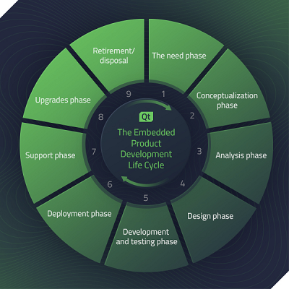
The primary stages of the embedded product development life cycle
The need phase
Conceptualization phase
Analysis phase
Design phase
Development and testing phase
Deployment phase
Support phase
Upgrades phase
Retirement/disposal:

Slide 3
The need phase
This step can occur for a new product or re-engineering or updating a current product.

Slide 4
Conceptualization phase
Engineers might perform a cost-benefit analysis and begin project management, risk management, and other planning steps.

Slide 5
Analysis phase
During this phase, engineers outline the business needs for the product, along with requirements for developing the product.

Slide 6
Design phase
The engineers develop a preliminary design document, which establishes the overall architecture for the product and design.

Slide 7
Development and testing phase
Engineers build the product into actual hardware and software. They test the product to see how it performs and make changes to ensure it works well.

Slide 8
Deployment phase
The product manufacturer deploys the embedded product into the marketplace.

Slide 9
Support phase
The manufacturer and engineers continue to support the product. They monitor that it's working correctly and quickly make fixes where necessary.

Slide 10
Upgrades phase
The manufacturer and engineering team continue to work on possible new versions of the product that can perform better.

Slide 11
Retirement/disposal
The manufacturer removes the product from the market as it becomes obsolete. This phase can happen as technology advances, and users' needs change.

