Slide 1
The Embedded Software Development Life Cycle

Slide 2
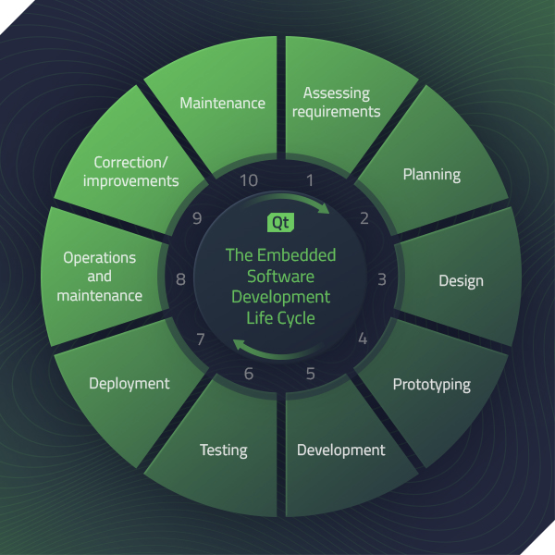
The primary stages of the embedded software development life cycle
Assessing requirements
Planning
Design
Prototyping
Development
Testing
Deployment
Operations and maintenance
Correction/improvements
Maintenance

Slide 3
Assessing requirements

Slide 4
Planning

Slide 5
Design

Slide 6
Prototyping

Slide 7
Development

Slide 8
Testing

Slide 9
Deployment

Slide 10
Operations and maintenance

Slide 11
Correction/improvements

Slide 12
Maintenance

