Slide 1
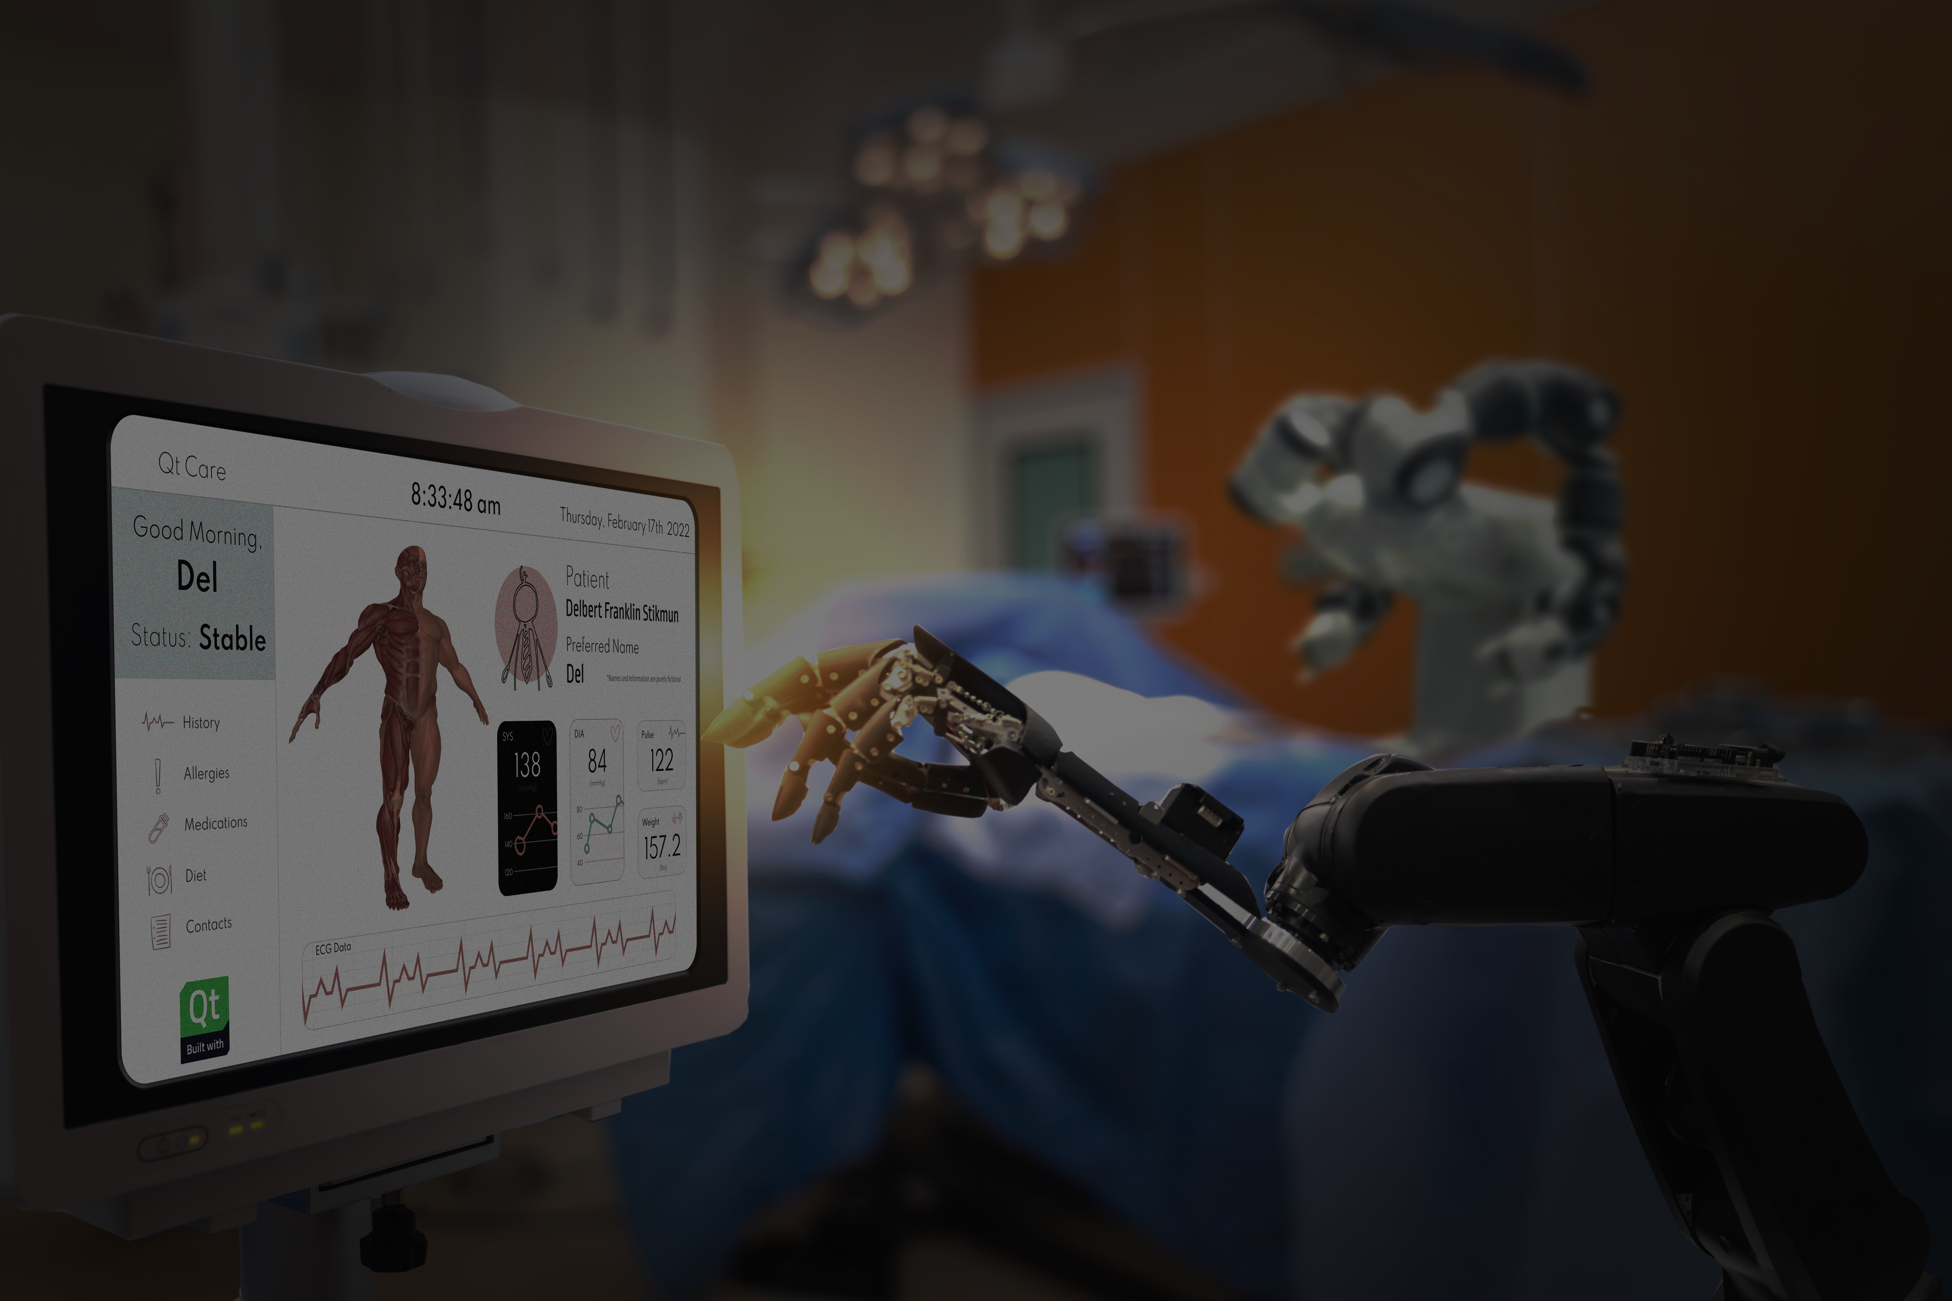
Addressing Medical and Industrial Challenges
February 17, 2022

Slide 2



Speakers
Addressing Medical and Industrial Challenges
Pat Shelly
Manager
Solutions Architecture
The Qt Company
Shawn Dorsey
Technical Artist
The Qt Company
Elton Lum
Director
Field Application Engineering
BlackBerry QNX

Slide 3
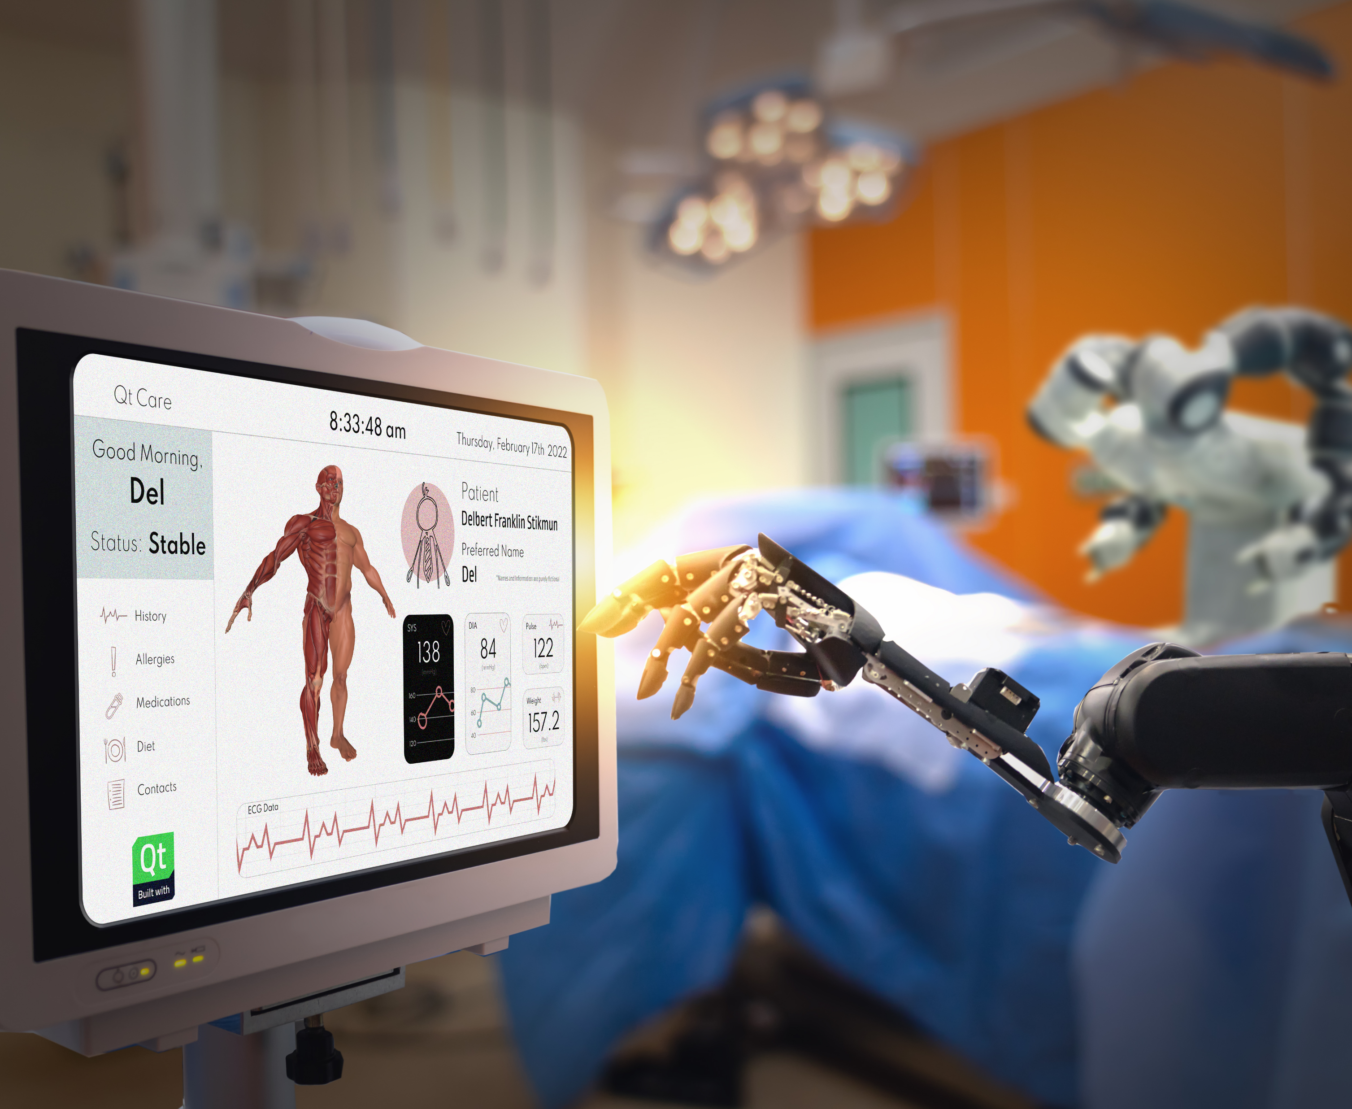
Introduction
Addressing Medical and Industrial Challenges
Functional safety is a major consideration when designing industrial and medical applications
  Parts of the system need to be certified, including some aspects of the HMI
  This is resulting in mixed-criticality systems conforming to International Electrotechnical Commission (IEC) safety standards
Qt and QNX have had a strong partnership for decades
This had led to a strong combined solutions for safety-critical systems
This webinar will look at how the Qt+QNX solution can be used to address some specific use cases

Slide 4
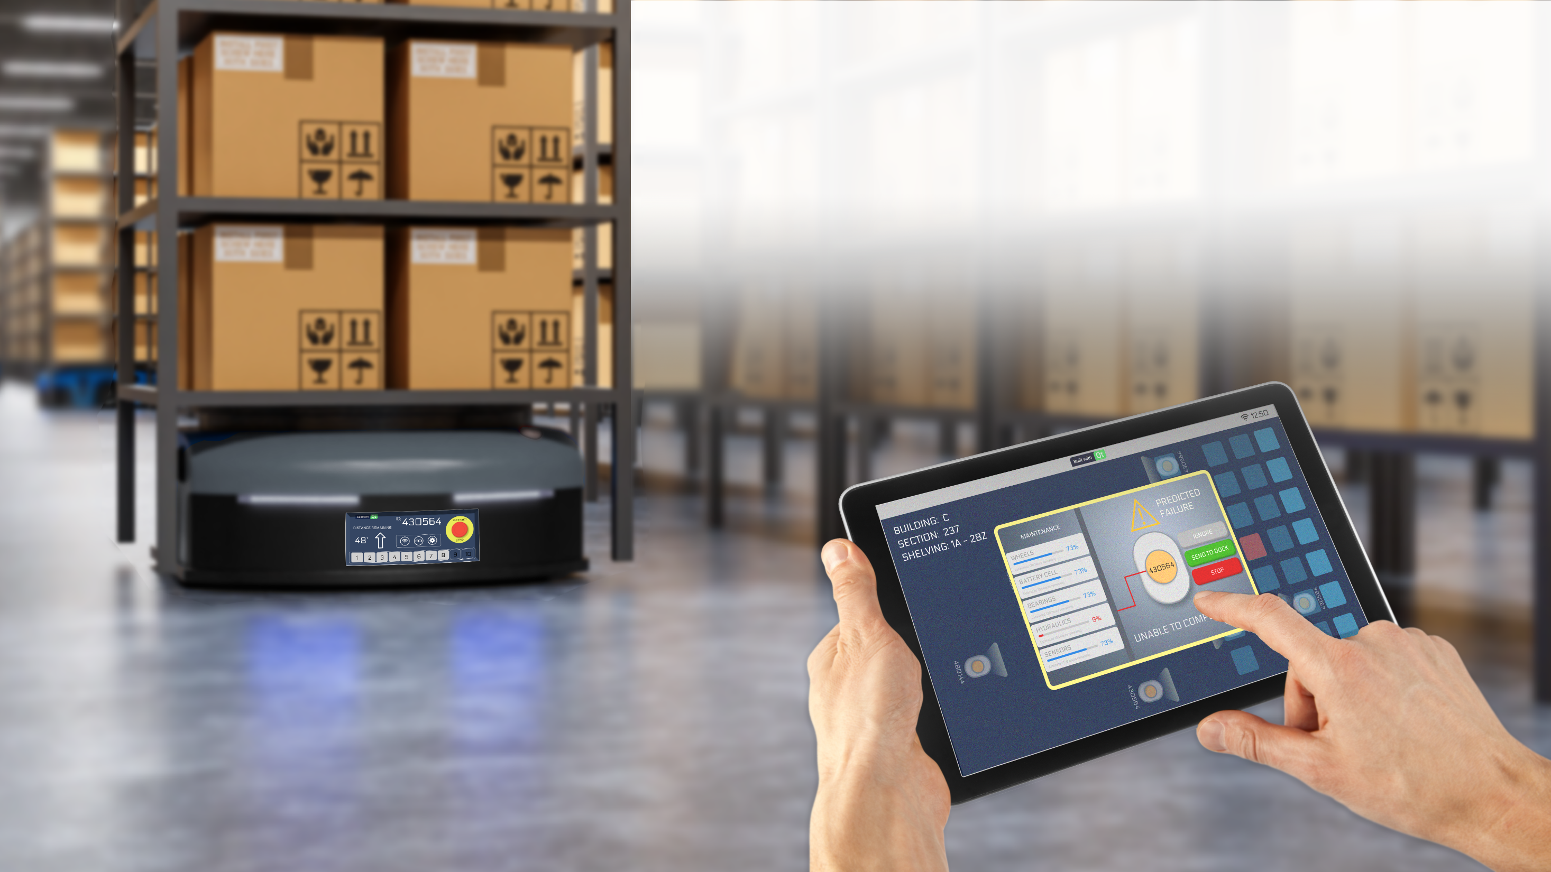
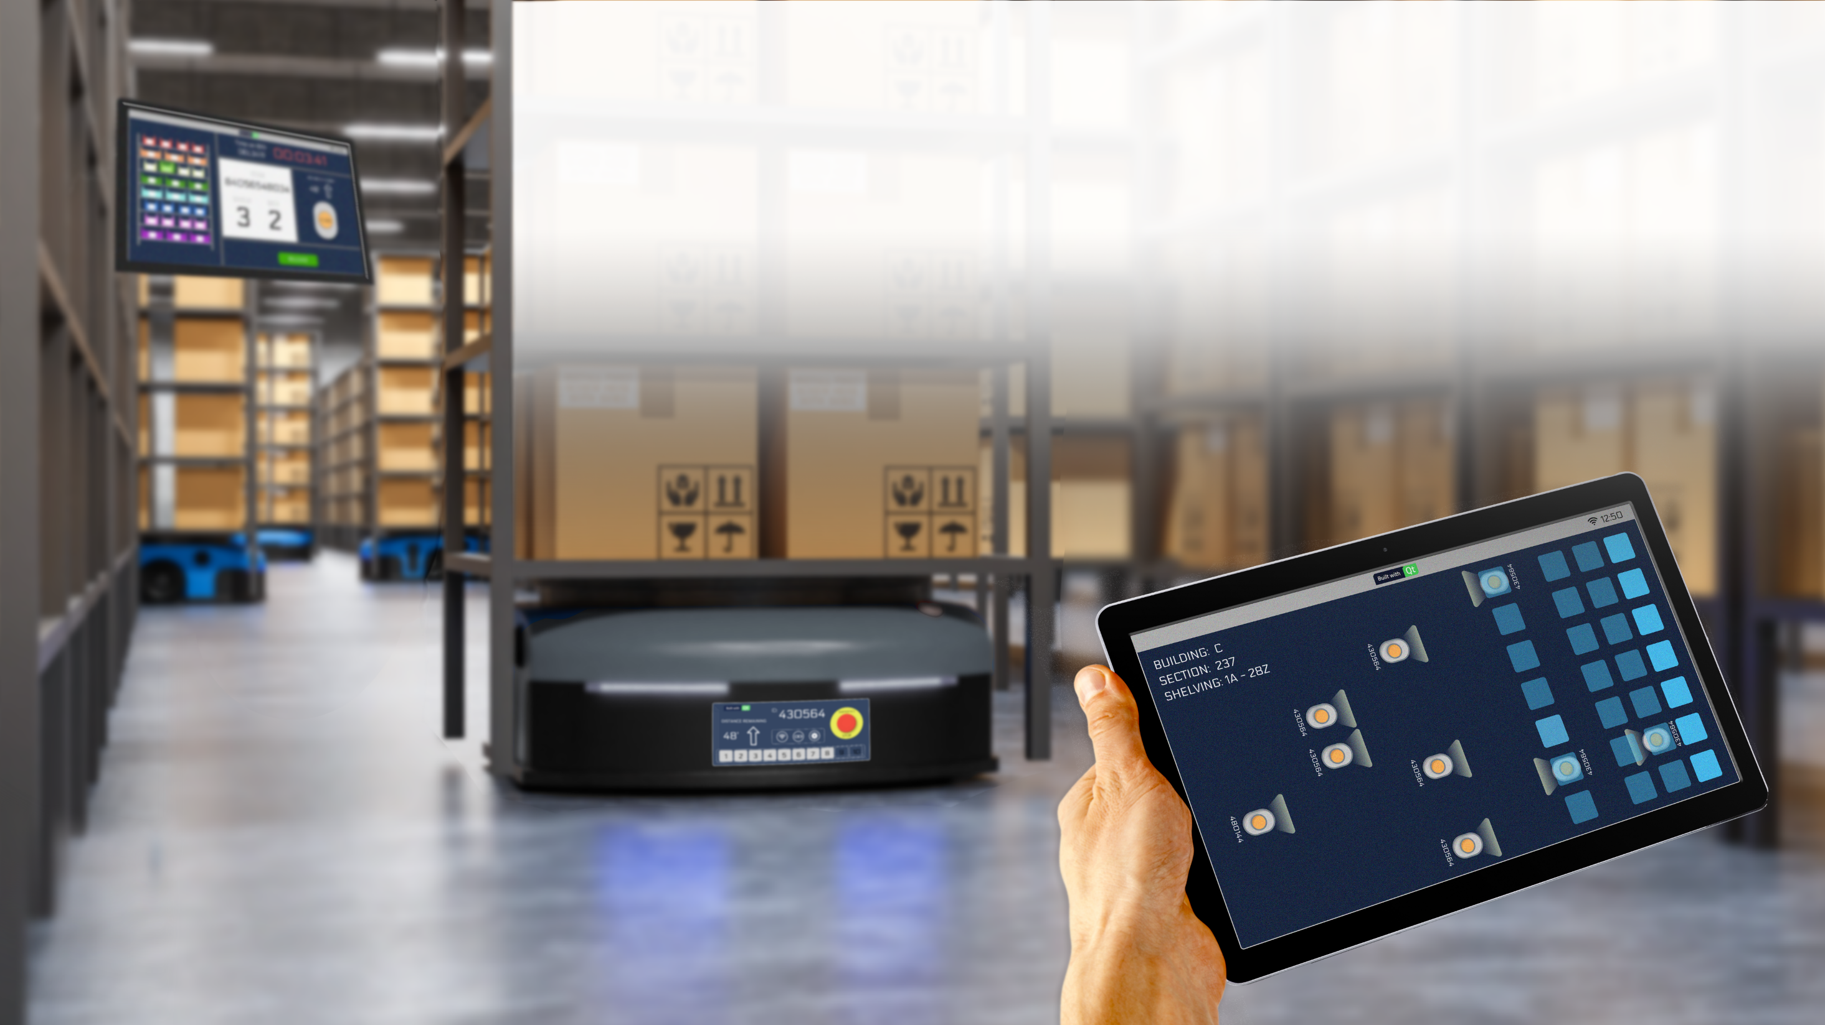




Smart Warehouse Solutions
Cross-platform, multi-screen Interactivity
Desktop
Tablet
MCU
4
23 February 2022
© The Qt Company

Slide 5
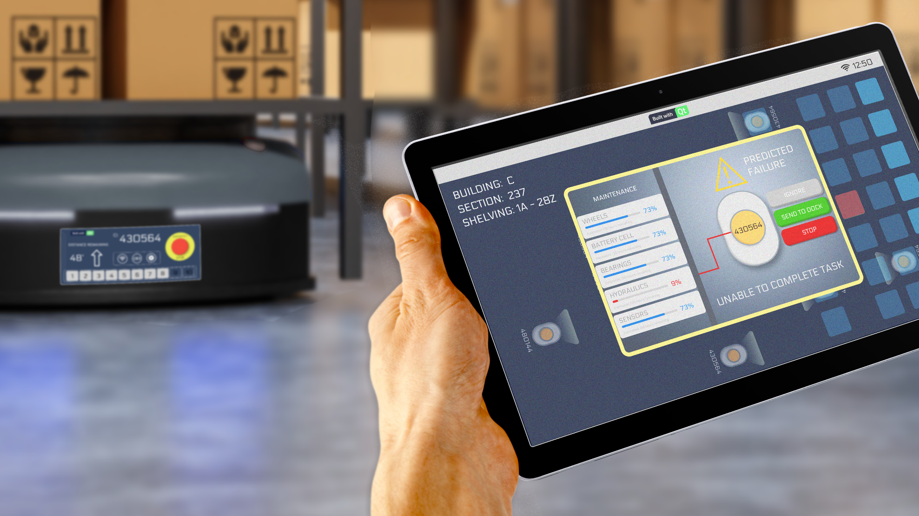

Qt Design Studio
Shawn Dorsey
Sr. Technical Artist
shawn.dorsey@qt.io
Notes:
Please add your own contact details to the presentation.
Two aspects to our approach to Android Automotive platforms:
1. What can we do to bring value on top of the AAOS platforms?
2. What are the pain points in native development that we could help alleviate?

Slide 6


UI Design
Layouts
Components
Interactions
Animations
Controls
Qt Bridge
Plugin
FIGMA
Design Studio

Slide 7
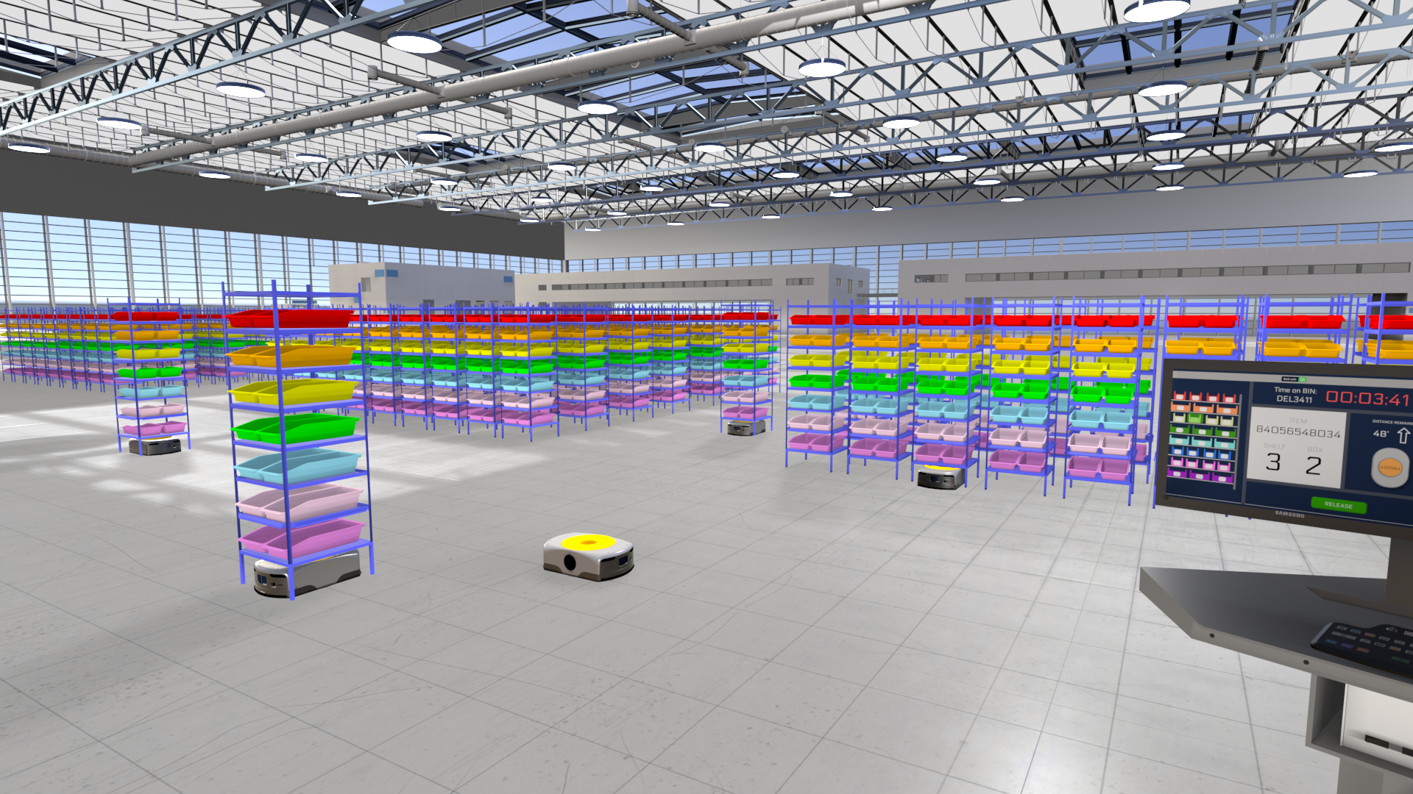


Interactive Virtual Warehouse
Notes:
Please add your own contact details to the presentation.
Two aspects to our approach to Android Automotive platforms:
1. What can we do to bring value on top of the AAOS platforms?
2. What are the pain points in native development that we could help alleviate?

Slide 8
Qt Safe Renderer
Addressing Medical and Industrial Challenges
Helps create a safe user environment in medical and industrial applications
  For example, in the Emergency Room, Operating Room or Intensive Care Unit
    Doctors and nurses can continue to focus on the patient in the event of a system failure
  On the industrial plant floor or warehouse
    Robot payload could fall resulting in personal harm or property damage
Qt Safe Renderer will ensure that the system is put into a safe state in the event of a system failure
Qt Safe Renderer is not required for your system to be certified
But Qt Safe Renderer will save you time and money
  We hold ourselves to the same safety standards as our customers do
  QSR is pre-certified for use in your system, we provide all necessary certification artifacts
  You can include these certification artifacts directly in your safety case
8
23 February 2022 - Public
Notes:
COTS/SOUP Transparency: Understanding that the Qt Safe Renderer is the certified tool in the software stack and that the Qt software in its entirety is SOUP, the question is often asked: Can Qt be used for the GUI of a safety critical medical device? The choice of technologies is up to the system designer. None of the standards will tell you to choose one software toolkit over the other. The manufacturer of the medical device is responsible for making sure that the medical device itself is safe and effective. Additionally, IEC 62304 requires that the manufacturer makes a conscious decision about their third-party software choice.
A device manufacturer will have to provide evidence of the following to satisfy the IEC 62304 requirements:
The software provides the functionality and performance required
The device provides the support necessary to operate the software within its specification
The software performs as required for the system

Slide 9
Qt Safe Renderer
Addressing Medical and Industrial Challenges
The QSR module provides a UI rendering component that can be used to render safety-critical items
  Examples include warning indicators and critical text messages in functional safety systems
Qt Safe Renderer separates the safety-critical rendering from the other parts of the system
  This ensures that Qt Safe Renderer can render the safety-critical UI elements even if there are failures in the main UI
With separation, Qt can be used in a system requiring certification without changing the Qt libraries
Qt Safe Renderer provides a seamless integration with the Qt toolchain
  Qt Design Studio and the QML language are be used together with Qt Safe Layout Tool to generate layout data for safety-critical UI elements
  Safety-critical elements are implemented using QML extensions: SafeImage, SafePicture, SafeText
QSR supports basic animations, and now includes a Safety Monitor feature to enable additional options for system architecture
9
23 February 2022 - Public
Notes:
Qt Safe Renderer allows customers to build partioned User Interface architectures ensuring that safety-critical graphics are running even when the main application has run into error.
Qt Safe Renderer relies on there being at least two graphics planes and this is usually the case SoCs. The safety critical graphics are written to the upper layer, the rich graphics to the layer below.​
​
The software is partitioned with the non-safety critical Qt running on one partition, the safety critical QSR on another.

Slide 10
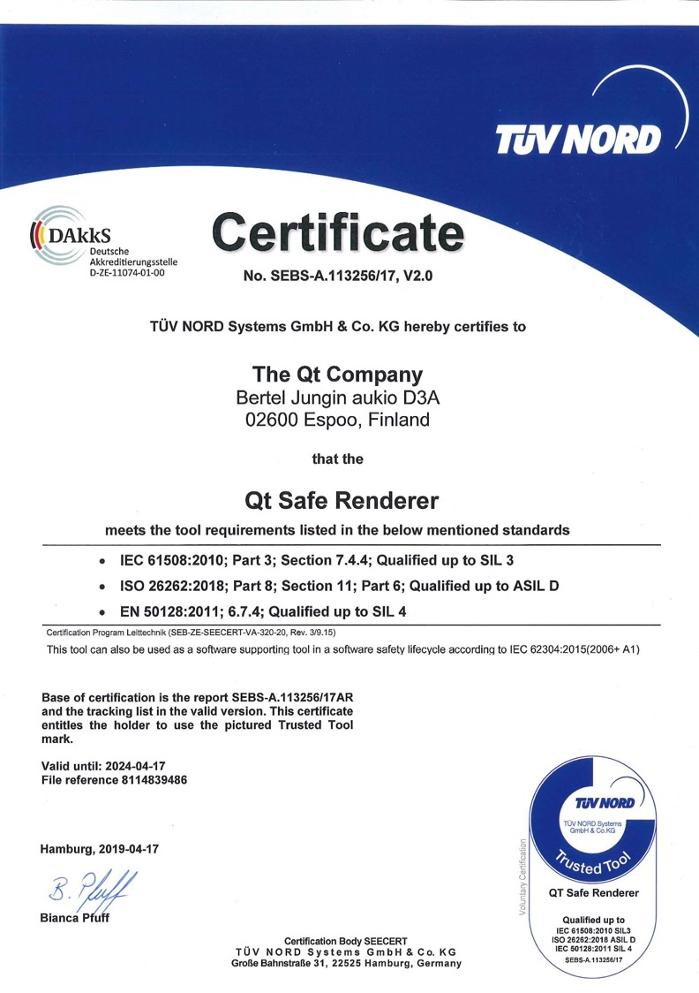
Certification Standards
IEC 61508:2010-3 7.4.4 (SIL 3)
(electrical/electronic/programmable safety-related systems)
IEC 62304:2015 (2006+A1)
(medical devices)
ISO 26262:2018-6, ISO 26262:2018-8 (ASIL-D)
(road vehicles functional safety)
EN 50128:2011 6.7.4 (SIL 4)
(railway applications)
10
23 February 2022
© The Qt Company
Notes:
Qt Safe Renderer has been certified to the following four standards.
The Automotive ISO 26262 ASIL-D is perhaps the most stringent of these standards.

Slide 11
Is Qt Certified for Functional Safety?
Like for any large framework, certification of the entire Qt framework is not economically feasible
  Codebase is too large
  Features making Qt a powerful and efficient framework considered risky for safety critical systems
    For example, Qt uses advanced C++ features and dynamic memory allocation
Solution: Partition the system and use Qt Safe Renderer
  Small code size easier to certify
  Uses MISRA C++
    Guidelines for the use of the C++ language in critical systems, was published and officially launched on 5 June 2008
    This has since been adopted by other industries as a de facto standard
  All memory allocated at startup, nothing while running
Rich UI
Safe UI
Qt
Qt Safe Renderer
QNX OS for Safety
Notes:
This is an optional slide that can be used with customers. It is largely educational as some who are not so well educated into what it takes to build functionally safe software will think Qt can be certified.
The point is that Qt itself is not certified (because it is not feasible) but a system using Qt can be certified by partitioning the system. The next slide will illustrate how this partitioning is done.
Emphasis that the reasons that stop Qt from being certified are strengths that make Qt great and are what all large software projects use.

Slide 12
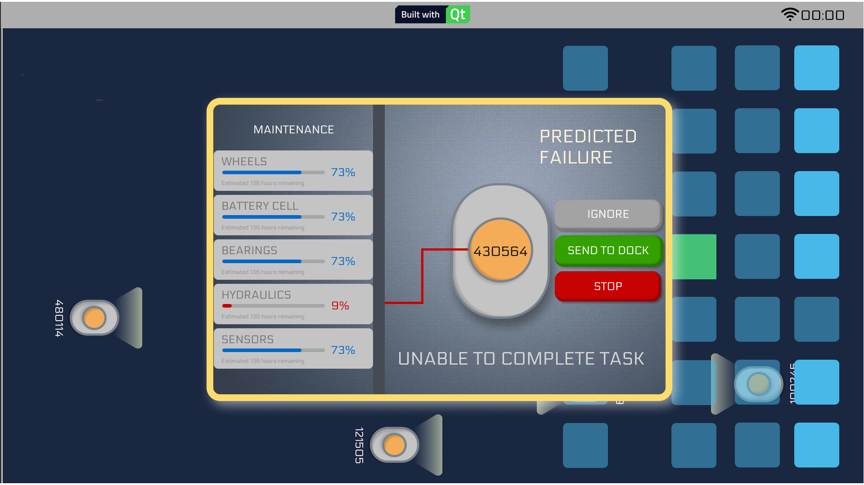
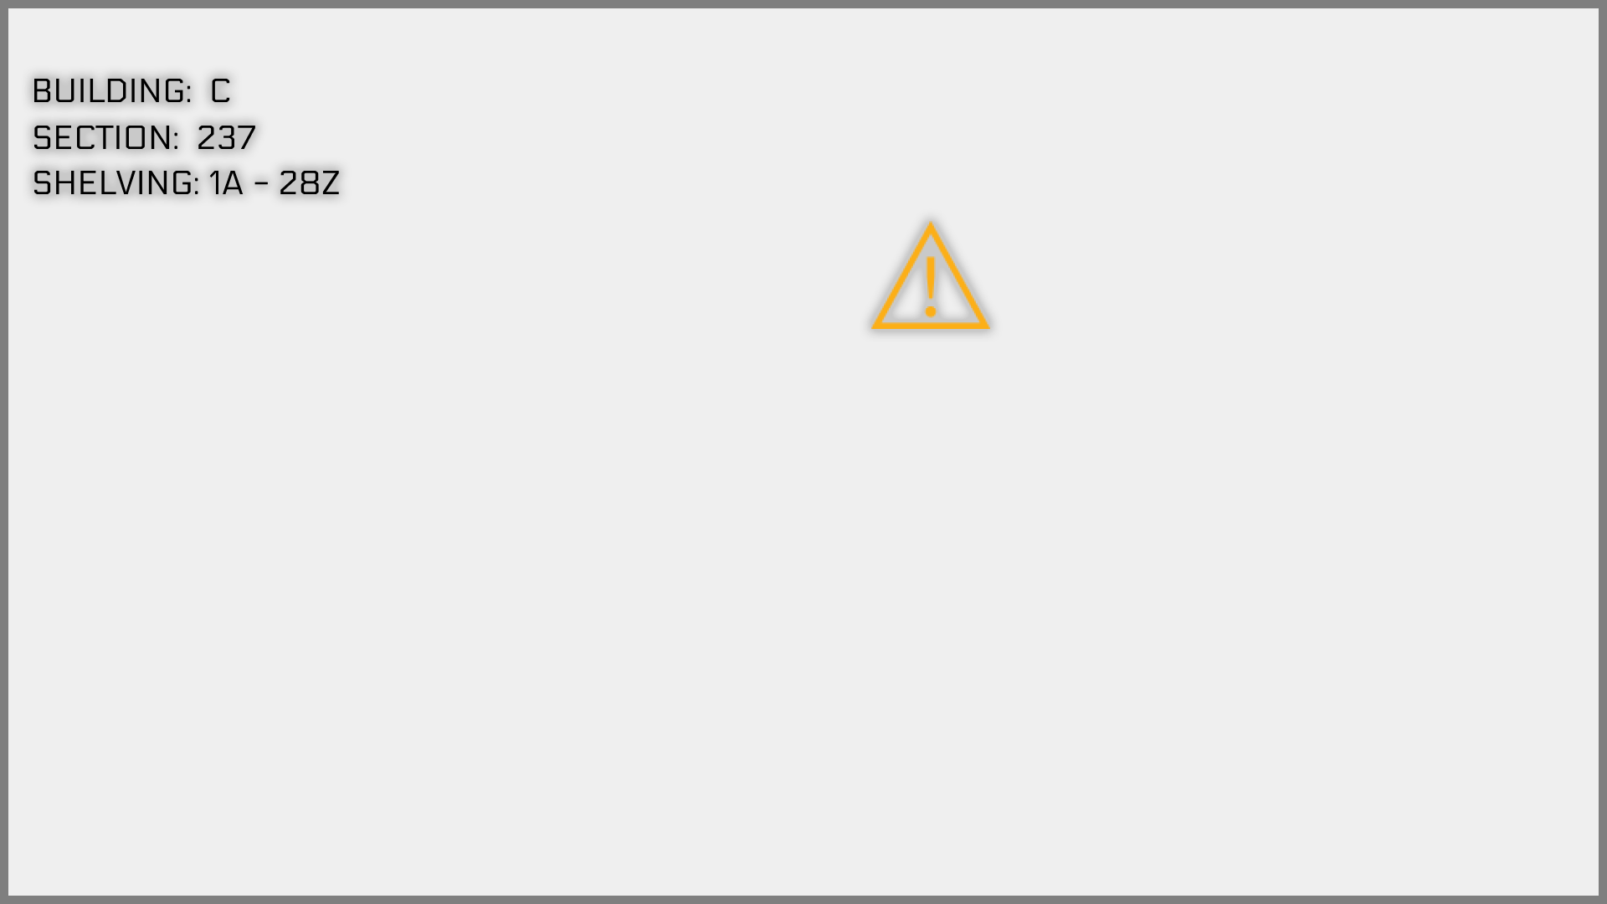
Safety Critical Graphics – Partitioned System
Non-safety critical graphics (2nd plane)
Safety critical graphics plane
Cluster UI
ASIL-D
Top layer
Tell-tales
Qt
Qt Safe Renderer
ASIL-D RTOS
Electronics
CANbus
Heartbeat from main UI monitored by QSR
Blanks out lower layers if error detected
Disables non-safety UI if error detected in its operation
Restarts non-safety UI if failure detected
Notes:
Here’s the technical details for how QSR works. It relies on there being at least two graphics planes and this is usually the case SoCs. The safety critical graphics are written to the upper layer, the rich graphics to the layer below.
The software is partitioned with the non-safety critical Qt running on one partition, the safety critical QSR on another. In this example the RTOS provides the partitioning. The RTOS should also be safety certified to allow the whole system to be certified. Here its shown as ASIL-D as that’s what QNX and INTEGRITY support for their safety certified RTOS.

Slide 13
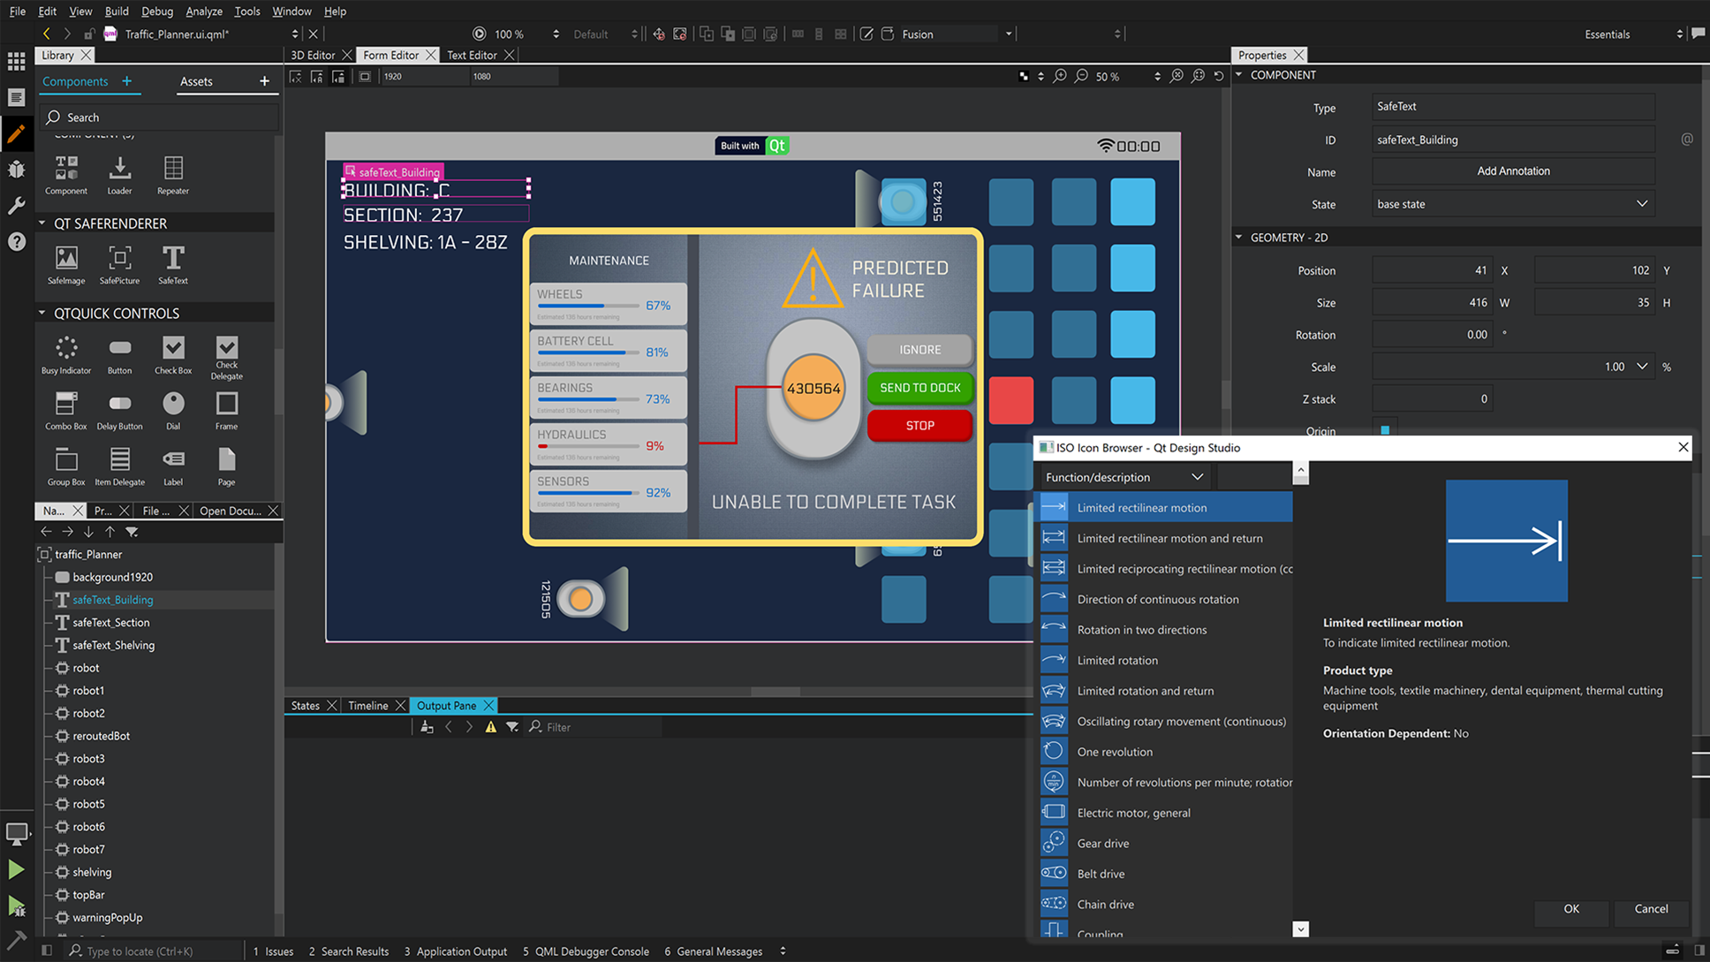
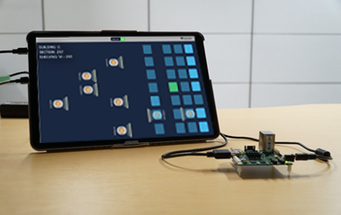
Qt Safe Renderer: We deliver four parts
Designer Tooling
One toolset to develop safety and non-safety critical UI
Build Tools
Pre certified component
Certification Artifacts
Safety manual, Architecture specification, Design specification, Verification specification, Verification report, ...
Automates partitioning
Run-time component

Slide 14
Designer Tooling
Drag and drop safe items from library into your design
Browser for adding ISO 7000 icons
Single tool for Safe and non-safety critical UI
Notes:
The Tooling includes ISO 7000 icons that can be dropped into a design using the ISO Icon Browser.
Key point to emphasis is that a single tool can be used to design the whole UI, even though there are parts that will be split into different partitions. This simplifies the designer’s role; the designer just needs to mark what is safety critical and the rest is taken care of.

Slide 15
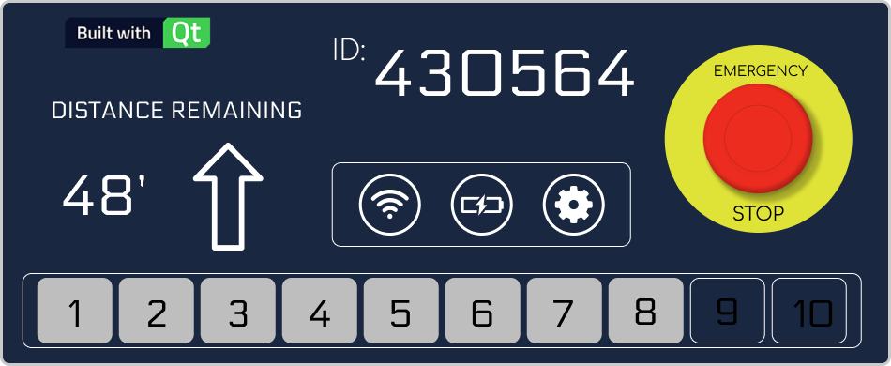
Build tools: Desktop or Target
Build for desktop: Rapid iteration during the design phase. Safe items rendered as normal QML items with no partitioning.
Robot UI with safe text
Qt
UI design
Software Build
Desktop OS
Rich UI
Robot UI
SIL
Build for target: Split design between safe and non-safe partitions.
Safe Text
Safety critical UI
Qt
Qt Safe Renderer
UI design
Software Build
QNX OS for Safety
Electronics
QSR Run-time component
Notes:
Being able to run the same project on either the desktop or on the embedded target is on of Qt key strengths. We continue this for the QSR so when the designer tests their design on the desktop all safety critical flags are ignores. This makes for rapid design iteration so the whole design can come together quicker.
When targeting the embedded system the build tools automatically separate the safe and non safety critical parts. This again makes for a very easy development experience.

Slide 16
New in 2.0: Safety Monitoring
Qt Safe Renderer
Customer Device
RTOS
QNX OS for Safety
QSR 2.0
Main UI
System Logic
QSR Monitor
QSR Render
State Logic
CRC Check
Main UI Watchdog
Main UI Heartbeat
QNX Hypervisor for Safety (Optional)
MCU
Serial
SoC
Robot Display
Notes:
With the QSR Safety Monitor available in QSR 2.0, additional system architectures can be supported. Instead of using a hypervisor to separate safety-critical rendering from the non-safe HMI, you can perform all safe and non-safe graphics rendering in an uncertified environment (meaning standard QNX and not QNX OS for Safety) and handle the safety checking on a separate, connected MCU device. This also eliminates the need for a hypervisor to separate the safety domain on the SoC.

Slide 17
Functional Safety at BlackBerry QNX
Follow your
Processes
IEC 62304
MEDICAL
At BlackBerry QNX, we adhere to a wide spectrum of safety standards as part of the product development lifecycle
It is in our DNA to follow processes and set safety goals for our products
We have a long history of proven safety critical product and services delivery
that customers can count on.
IEC 61513
NUCLEAR
TECHNIQUE TO PROCESS ORIENTED
EN 50128
RAILWAY
ISO 26262
AUTOMOTIVE
Use
technique X
IEC 61508
INDUSTRIAL
PRESCRIPTIVE TO GOAL BASED
Do X & Y
Don’t do Z
Design a
safe system
© BlackBerry QNX
Notes:
The original Functional Safety Standard for such systems, called IEC 61508, was published 2 decades ago.
It has since been used at the basis for other functional safety standards, which have been adapted to specific “fields”.
And they are not one side fits all, IEC 61508 is prescriptive and calls for specific techniques, while ISO 26262 for automotive is more goal based, EN 50128 calls for independence and role definition and IEC 62304 is more about following your own processes.

Slide 18
QNX OS for Safety Scope
Applications
QNX Black Channel
QNX® OS for Safety (QOS)
Compatible with QNX SDP 7 with support for ARM and x86 64-bit hardware platforms
Microkernel and Process Manager, Multicore support, Adaptive Partitioning scheduler
System libraries: C, Math and C++ Library certifications
Various certified QNX® utilities
Tools: C and C++ compiler, linker, and assembler classified as TCL3 according to ISO 26262 and T3 according to IEC 61508-3
Safety Certified Add-ons
Certified C++ System Library
QNX® Black Channel Communications Technology
Fsys/Block
Network
Other Drivers, Libraries and Tools
C and C++ compilers
C++ library
C
library
Math library
Support Services
SMMU
mkifs, secpolcompile, secpolpush
QNX Microkernel+Procnto
Adaptive Partitioning
Multicore
support
Memory Management
Board Support Packages (BSP)
Safety Legend
Startup
Drivers
Add-ons
QNX OS for Safety
Eng Services
© BlackBerry QNX

Slide 19
Understanding the Difference
Safe communication and secure communication do not mean the same thing
Secure communication relates to protecting your data from malicious threats and requires frequent patching of software and firmware to combat new threats
Safe Communication relates to the automatic prevention of accidents from Systematic software faults, random hardware faults and transient faults despite malicious threats
© BlackBerry QNX

Slide 20
Customer Needs
Provide Customers with a safety certified mechanism to exchange data over unsafe communication links (e.g UDP, TCP/IP, CAN)
IEC 61508 specifies requirements to accomplish Safe Communication:​
  White Channel – time consuming, expensive and burdensome​
  Black Channel – cost effective, convenient and favorable​
ISO 26262 and IEC 61508 specifies fault detection mechanisms for Safe Communication
Application
Application
Communication Stack
Communication Stack
Communication Driver
Communication Driver
Hardware
Hardware
© BlackBerry QNX

Slide 21
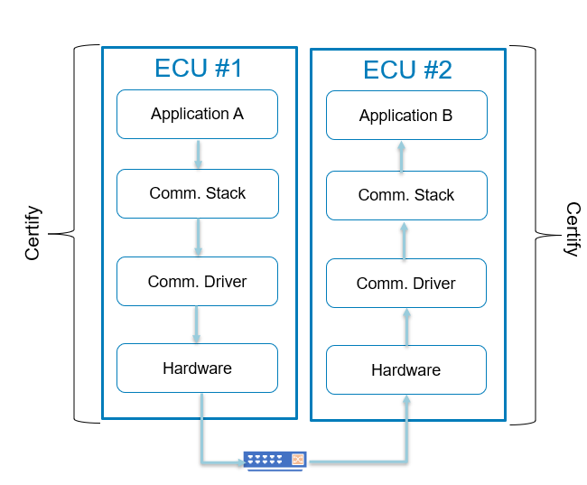
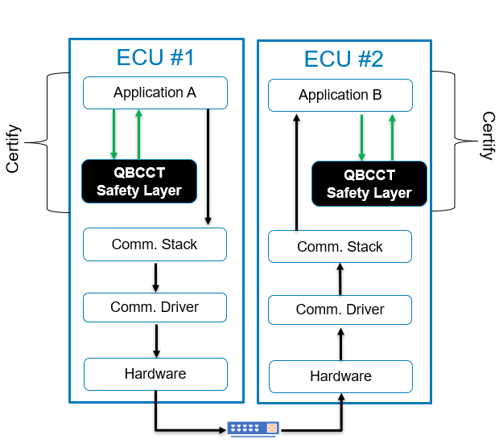
Safety Layer Approach
Generic Model White Channel
QBCCT* Safety Layer Model Black Channel
Sender
Receiver
Sender
Receiver
*QBCCT = QNX Black Channel Communications Technology
23 February 2022
© BlackBerry QNX
Notes:
For the white channel approach, if we look at the diagram on the left, you will see two applications that are on two separate pieces of hardware that send data back on both. To establish safe communication for this scenario using the white channel approach, you will have to certify every single aspect of the communication path to the functional safety standard that is required for your system. That included the communication protocol, services and underlying hardware. This will clearly reduce the risk of hardware and software fault introduction in your system. However this approach is extremely costly and time consuming to be able to certify all these elements to the functional safety standard
For the black channel approach, the use case is the same on the right where you have two applications communicating on two separate pieces of hardware. The Black Channel approach recommends a Safety layer that sits at the application level where the sender application sends its data to for essential safety checks prior to transmission and on the receiver side upon receipt of the data you send it to the safety layer to check to make sure the data hasn’t changed. That safety layer has to be safety certified as well as the application however, given the fact you have the safety checks on both sides of the sender and receiver, the approach highlights that you don’t need to safety certify the components underneath like the communication stack, comm driver and hardware. This is clearly cost effective and less time consuming when it comes to safety certification. It also allows you to use uncertified communication components in your design.

Slide 22
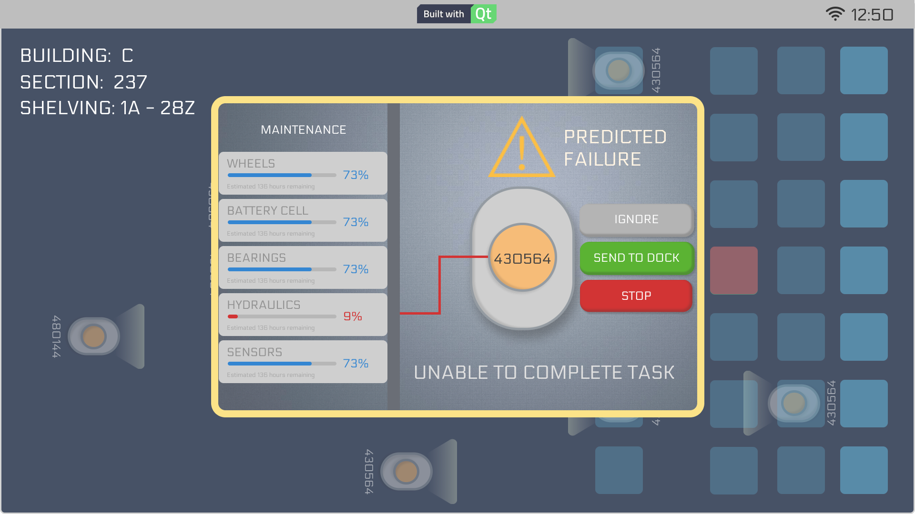

QNX Black Channel Communications Technology
Provides a Safety Layer to protect data exchange. Hardware agnostic
Fault Detection as per the IEC 61508, ISO 26262 and AUTOSAR.
Reduces or eliminates the cost to QNX customers of integrating communication components ​.
  “you don’t need to certify the network stack if you use QNX Black Channel Communications Technology”
Runs at the application level on QNX or Linux® or SafeRTOS®
H/W #1
H/W #2
Application A
Application B
QT Application
QT Application
Data
Data
QBCCT Safety Layer
QBCCT Safety Layer
QBCCT
Data
QBCCT
Data
Comm. Stack
Comm. Stack
Comm Header
QBCCT
Data
Comm Header
QBCCT
Data
Comm. Driver
Comm. Driver
Hardware
Hardware
© BlackBerry QNX
Wi-Fi

Slide 23
Black Channel Fault Detection Measures
Faults | Description
Incorrect Addressing | Information is accepted from an incorrect sender or by an incorrect receiver.
Corruption | Information is modified or changed on the comm. channel
Repetition | Information is received more than once.
Incorrect Sequence | Information sequence modified on the comm. channel.
Loss | Information removed (totally or partially) from comm. channel.
Insertion | Information added or inserted on comm. channel.
Masquerade | Non-authentic information is accepted as authentic information by a receiver.
Asymmetric information to multiple receivers | Information received by receivers differs for the same sender on the comm. channel.
Reception only by subset | Information is not received by all receivers on the comm. channel.
© BlackBerry QNX
Notes:
So what are those safety checks that the safety layer for Black Channel looking for? The safety layer has to check the data to ensure the faults in the table here are not detected. This list is defined in the IEC 61508 and ISO 26262. that layer has to check for incorrect addressing, corruption, repetition, incorrect sequence, data loss, data insertion, data masquerade, asymmetric information to multiple receivers, reception only by a subset of receiver and lastly delay of information. As you can see the list is quiet comprehensive and covers a lot if not all of the hardware/software faults that could arise in any system that are not malicious.

Slide 24


Key Takeaways
Addressing Medical and Industrial Challenges
Qt and QNX provide a great combined solutions to address functional safety requirements in medical, industrial and other market segments
Using the pre-certified components will save time and money on safety-critical applications
We would love to discuss your specific situation

Slide 25
Thank you!

