Slide 1
Qt 6.2 LTS vs. Qt 5.15: The big feature parity comparison
Maurice Kalinowski
Product Director, Technical PM @TQtC
2021/09/14

Slide 2
Agenda
Qt 6: From technical vision to release
Progress since 6.0
Where are we? Highlights
Migration
Outlook

Slide 3
Qt 6 – Technical Vision
Article:
Next-generation graphics
Next-generation QML
Unified and consistent tooling
Enhancing C++ APIs
Language Support
https://www.qt.io/blog/2019/08/07/technical-vision-qt-6
Long-term support
1.0
2020
2.0
3.0
4.0
5.0
6
1995
1999
2001
2005
2012

Slide 4
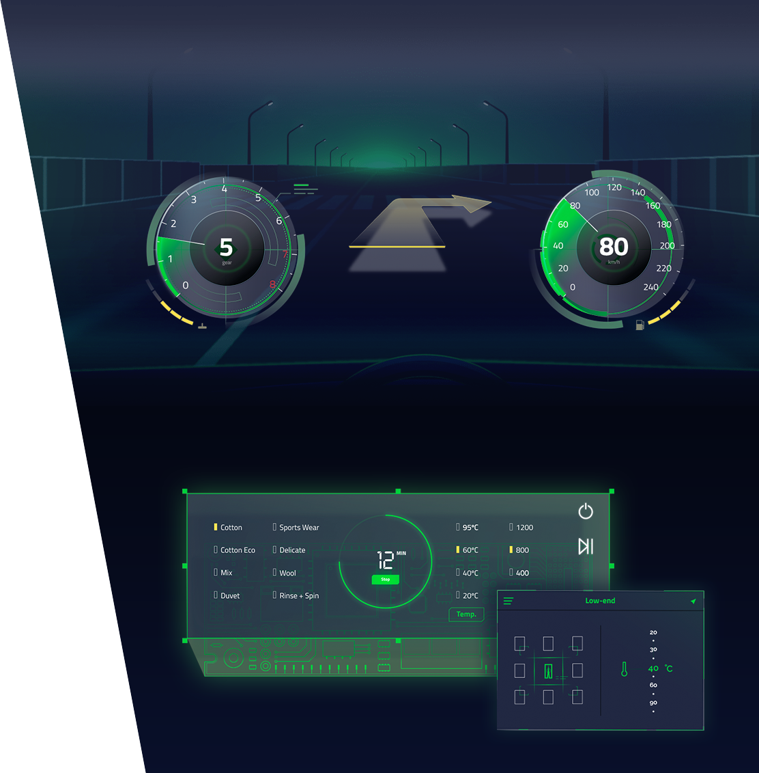
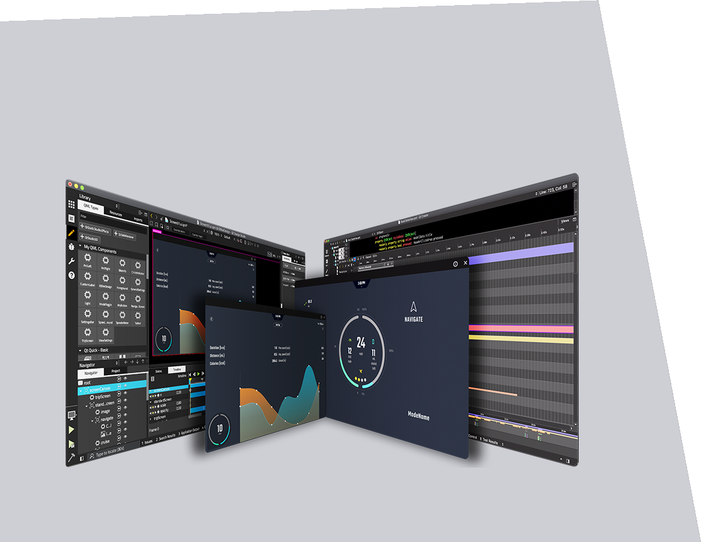
Qt Objectives
Next-Generation User Experience
Productivity Platform for the Future
Limitless Scalability

Slide 5
How to get there?

Slide 6
Iterative approach on timebased principles
Step 0: Modularization
Split Qt modules into categories
Started at Qt 5.0
Qt
AddOns
Step 1: Form vision into implementation
Modernization, NextGen, Toolability
Focus on core set (Qt 6.0)
Essentials
Step 2: Transfer modernization to all modules
While applying modernization to those
Qt 6.1.. Qt 6.2

Slide 7
6.0: The initial Qt 6

Slide 8
Qt RHI
RENDERING HARDWARE INTERFACE
Create hardware-accelerated user-interfaces on any rendering platform
OpenGL, Vulkan, Direct 3D, Metal
New Qt Shader Tools
Write rendering code once, deploy to any hardware
Add new hardware targets in no time

Slide 9
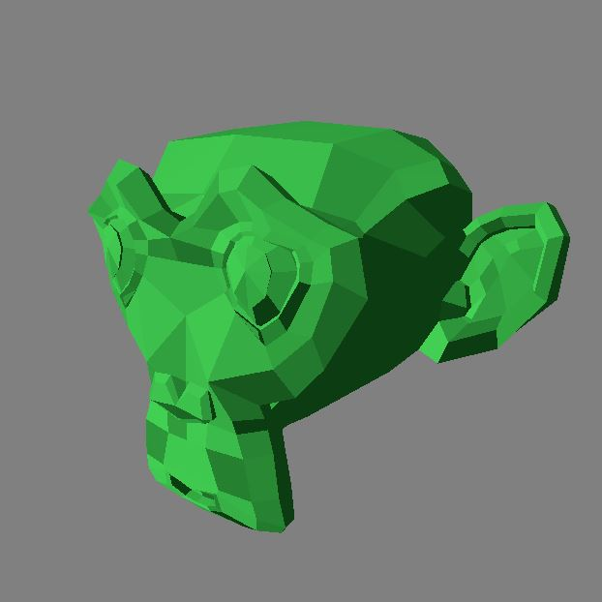
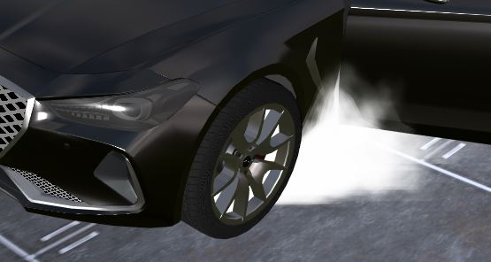
2D and 3D in one scene
Next-Gen user interfaces
Create the WOW effect in your UI
Customized and branded experiences
Native Look & Feel where needed
Fully toolable with Qt Design Studio

Slide 10
Modernization, Updates, Refactorings...
Platforms
Mac on ARM
Windows on ARM
WebAssembly
Latest Android and iOS
C++17
Qt Quick Controls Desktop Styles
HiDPI
Native Interfaces
Qt for Python
All modules available to Python bindings
Shiboken generator
QML Tooling
qmllint, qmlformat
Renewed Property System
C++ Bindings
Package Management

Slide 11
QVariant and QMetaType sharing infrastructure
Fast lookup
Compile-time type checking
QHash/QMap improvements
QRegularExpression based on PCRE2
...
PERFORMANCE
WHAT‘S MORE?
More changes under the hood
CONVENIENCE
Containers updated to support 64bit
QList QVector merged
String handling updates
All text handling Unicode based
No more need for manual conversion
...

Slide 12
From 6.0 to today, 6.2

Slide 13
Module migration / updates
Qt Framework
6.0 (Dec 2020)
6.1 (May 21)
6.2(Sept 21)
Available
Qt Core
Qt Gui
Qt Network
Qt QML
Qt Quick
Qt Quick Controls 2
Qt Quick 3D
Qt SQL
Qt Widgets
Qt Concurrent
Qt Dbus
Qt Help
Qt OpenGL
Available
Active Qt
Qt ScXML
Qt Virtual Keyboard
Qt Charts
Qt Data Visualization
Qt Device Utilities
Available
Qt Bluetooth
Qt Quick Dialogs
Qt Positioning
Qt Multimedia
Qt Remote Objects
Qt Sensors
Qt SerialBus
Qt SerialPort
Qt WebEngine
Qt WebSockets
Qt WebChannel
Qt WebView
Qt Android Extras
Qt Lottie Animation
Qt NFC
Qt Printing Support
Qt Quick Timeline
Qt SVG
Qt UI Tools
Qt XML
Qt 5 Compat
Qt Shader Tools
Qt Image Formats
Qt 3D
Qt Network Authorization
Qt CoAP (M2M AddOn)
Qt MQTT (M2M AddOn)
Qt OpcUA (M2M AddOn)

Slide 14
What about module... ?
A very small fraction of modules have not been migrated to Qt 6
This does not imply permanent removal or such from Qt
Individual decisions based on demand and technical approach
We are actively monitoring and listening to the feedback from all angles, Open Source and Customers
Qt PDF
Chromium dependencies
Active progress https://code.qt.io/cgit/qt/qtwebengine.git/tree/src/pdf
Qt Speech
Active contributions https://codereview.qt-project.org/q/project:qt/qtspeech
Design Decisions pending
Qt Gamepad
Design Decisions pending
Qt Location
Major effort
Is it the right solution for most use-cases?

Slide 15
Additional new functionality
Building upon 6.0 enablers
Qt Quick 3D
Instanced Rendering
Particles, Morphing...
Qt Network
QNetworkInformation
TLS backends
Android
Public JNI API
QNX 7.1
Embedded Linux
Added new hardware references
https://wiki.qt.io/New_Features_in_Qt_6.1
New Qt Multimedia
Slimmer
Refactored API to make more use cases easier to use
Qt Quick Dialogs
Native desktop dialog integration
QML Tooling
qmllint, qmlformat, ...
Integrity 19.0.13
https://wiki.qt.io/New_Features_in_Qt_6.2

Slide 16
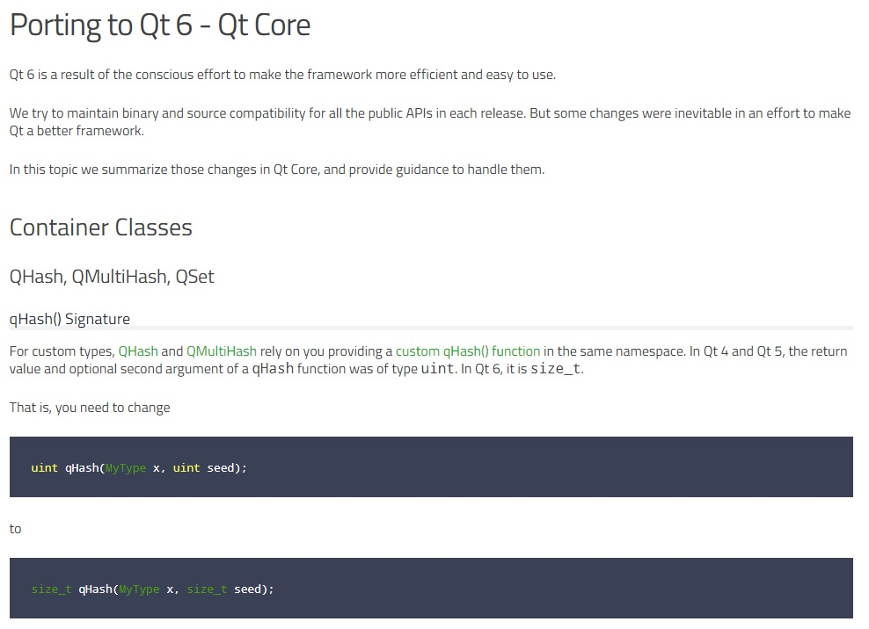
Migration Support
TOOLS & DOCUMENTATION
Compile Qt 5 in “Qt 6 – mode”
Start from 5.15
QT_DISABLE_DEPRECATED_BEFORE
Compatibility module
Qt5Compat
Documentation
Porting section for each module
Tooling
Based on clazy
Videos / Webinars
https://www.youtube.com/watch?v=wuuyzR7dqfg

Slide 17
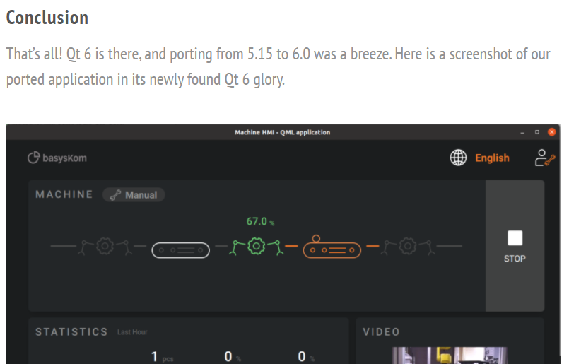
Experience from partners and ecosystem
Basyskom
VoidRealms
Embedded Use

Slide 18
Outlook
More details on Qt World Summit, Nov 3-4
Register here: https://www.qt.io/qtws21
Content
Continuation of QML Vision
Static, Strict, Dynamic
QML to C++
Further Tooling creation / enhancements
Qt for WebAssembly
Desktop and Mobile
Strengthen Embedded portfolio

Slide 19
Summary
Thank you
Qt 6 is ready for adoption of existing projects
Large majority of Qt 5 modules available, small fraction remaining
6.2 is the first LTS version within Qt 6
Qt 6 offers a lot of new features and enablers
Modernization, Performance
Future-proof
We‘re eager for your feedback
And see what you‘ll create with Qt 6

